Slide 1
Sure-Park: Parking lot management system
2016/6/24
5 (Oh!) Team

Slide 2
Contents
Overview
Project in detail
Analysis
Design
Test
Management
Lessons learned

Slide 3
1. Overview
The project sponsors is Geoff’s Transportation and Parking Services (GPTS LLC).
GPTS LLC own several parking garages and lots, have concerns about inefficiencies in their parking garages and lots.
We have to enable drivers to easily find a parking facility with available parking slots and reserve them.

Slide 4
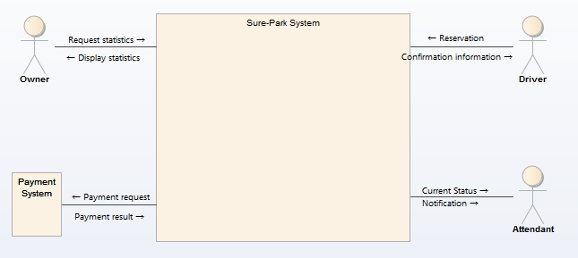



1. Overview
System context diagram
Actors
External System

Slide 5
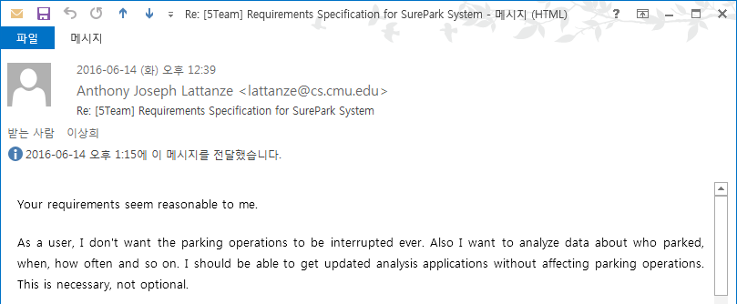
2. Analysis
We analyzed system with
18 quality attributes
64 functional requirements
9 business/technical constraints
We made a baseline with customer (6/14)
Customer said
: “Your requirements seem reasonable to me!”

Slide 6
2. Analysis
Significant quality attributes
QA ID | Quality Attributes | Priority | Difficulty
QA-18 | (Usability) User shall be comfortable using parking lot. | H | H
QA-08 | (Extensibility) Owner add a parking lot, maximum 5. | H | M
QA-14 | (Availability) System shall be available for 24 * 7 * 365 without stop. | H | H
QA-17 | (Performance) System shall make a response in 3 seconds. | H | H
QA-15 | (Security) System shall store private data with encryption | M | L
①
②
③
① what we really focused
② what every team did
③ Relatively easy one

Slide 7
2. Analysis
Main functional requirements
3. Park a car
1. Manage
2. Reserve a slot

Slide 8
3. Design
Early design decisions
ID | Details | Design
CST-13 | The system should use Arduino MEGA 2560 (Wi-Fi enabled). | Independent parking lot
FR-201 | System shall provide at least one method for parking lot reservation. | Independent reservation device
FR-304 | System should be able to receive the confirmation information from driver. | Independent interaction device
Parking lot
Reservation
Device(s)
Interaction
Device(s)
: Identified elements

Slide 9
3. Design
Identified roles
Roles | Responsibility | # of reqs. | Assignee
ParkServer | * manage reservation, parking, statistic data * manage authority : owner, driver, attendant | 62 (97%) | Yongchul Park, Jaedo Jin
ParkingLot | * control devices in parking lot by management system's request * monitor sensors in parking lot and send to management system | 16 (25%) | Daedon Jeon
ParkHere | (Owner) * display statistics for parking lot * manage authorities for registered attendants * manage parking lot price, grace period * add/remove parking lots | 17 (27%) | Kimoon Lee
 | (Attendant) * display current status of parking lot * receive notification for emergency | 3 (5%)
 | (Driver) * reserve a parking slot with reservation information * display reservation information with confirmation information * can cancel the reservation | 12 (19%)
ParkView | * interact with driver at entry gate * display/speak welcome message * receive confirmation information from driver via QR code * display/speak assigned parking slot information | 3 (5%) | Yongchul Park
Notes:
# of requirements 는 좋은 기준이 아니다. -> ok, 참고용으로 사용하였다.

Slide 10

3. Design
Dynamic perspective
Alternative #1 : client-server #1
Process
Connector (server-client)
Connector (database)

Slide 11
3. Design
Dynamic perspective
Alternative #2 : client-server #2 (integrated server)
Process
Connector (server-client)
Connector (database)

Slide 12
3. Design
Dynamic perspective
Alternative #3 : shared repository with middleware
- Asynchronous Bus
- TCP/IP
- No centralized server
Process
Connector

Slide 13
3. Design
Dynamic perspective
Decision by quality attributes
Alternatives | Promotes | Inhibits | Remarks
Client-Server (#1) | - Extensibility : we can add multiple clients without any modification of program. - Modifiability and reusability : by factoring out common services and having to modify these in a single location, or a small number of locations. | - Availability : Server can be a single point of failure. - Performance : Server can be a performance bottleneck | - We need additional tactics for compensation of availability and performance.
Client-Server (#2) | - Scalability : multiple server can support better performance. - Modifiability and reusability : by factoring out common services and having to modify these in a single location, or a small number of locations. | - Availability : Server can be a single point of failure. | - Server is proved to be a performance bottleneck. Arduino cannot support server role.
Shared repository w/Middleware (#3) | - Modifiability : activities are performed by data, not by services. It removes dependency between services. - Portability and interoperability by defining standard interfaces | - Availability : Repository can be a single point of failure. - Performance : Repository can be a performance bottleneck. This architecture cannot make simultaneous response. | - We need additional tactics for compensation of availability and Performance, especially on response time.

Slide 14
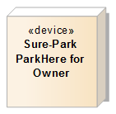
3. Design
Physical perspective
Early design decision + dynamic perspective
TCP/IP, WiFi
Physical device
Wireless connection
TCP/IP, WiFi
Android
device
Arduino
TCP/IP, WiFi
Laptop
TCP/IP, WiFi
Android
device
Android
device
TCP/IP, WiFi

Slide 15
3. Design
Static perspective
1st Decomposition : functional decomposition
Element
Association

Slide 16
3. Design
Static perspective
2nd Decomposition : ParkServer (Layered)
Element
Association

Slide 17
3. Design
Static perspective
2nd Decomposition : ParkHere (MVC)
Element
Use
Realization
Generalization

Slide 18
3. Design
Sub-system design
ParkServer : dynamic perspective
Process
Connector (post, callback)
Connector (call-return)

Slide 19
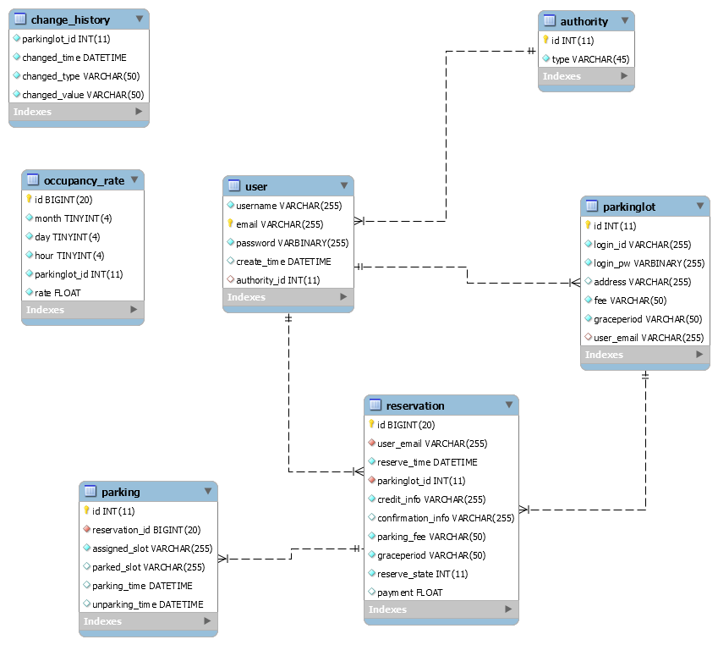
3. Design
Database design
Flexible structure
User data
: user data for actors
: preparation for authority expands
Storing statistic data
: occupancy rate
: change history for parking fee, grace period
Parking lot data
: data for multiple parking lots
: fee, grace period is stored in here
Storing reservation data
: reservation data created when driver request reservation
: parking data created when parking happened

Slide 20
3. Design
Various tactics
Performance
Manage sampling rate
Schedule resource
Availability
Heartbeat
Timestamp
Security
Authentication actors
Encrypt data

Slide 21
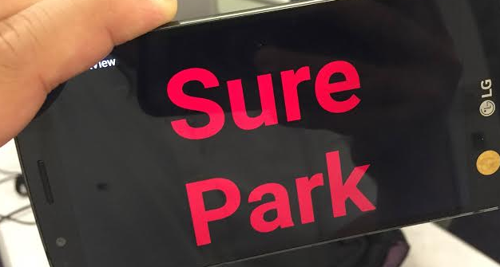
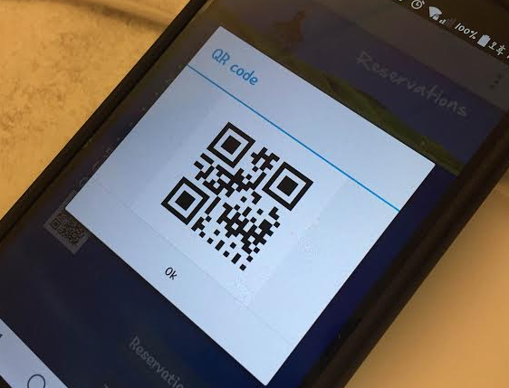
3. Design
Various tactics
One more thing, usability
To make our system better, we promote usability
Easy to use, User friendly, Easy to handle…

Slide 22
3. Design
Verification
Traceability matrix
We coverer every requirements in design
We will check the functional coverage by test

Slide 23
4. Test
64 test cases for integration, system level test
Unit test is done by developer
Integration test : 26 test cases
System test : 38 test cases
Test results
Level | # of TC | 6/22 | 6/23 | 6/24
Integration | 26 | 23 | 26 | 26
System | 38 | 14 | 38 | 38
Total | 64 | 37 (58%) | 64 (100%) | 64 (100%)

Slide 24
4. Test
Once again, usability
Reduced time using QR code : 5.3 → 2.0 seconds
Customer survey for satisfaction (5 people)
Criteria | 5 Team | Other team
Overall satisfaction | 4.4 | 3
Easy to use | 5 | 3
User friendly | 4 | 3
Easy to handle | 4 | 3
Speed | 5 | 3
Preference | 4 | 3

Slide 25
5. Project management
Time log
We use pretty much time to complete
272 hour!

Slide 26
5. Project management
Variance analysis on schedule and cost
Typical project style of Korean
Not accurate estimation at planning but no changes on planning
Pouring efforts at the end of project
Finally successful

Slide 27
5. Project management
Performance index analysis on schedule and cost
Cost-inefficient project

Slide 28
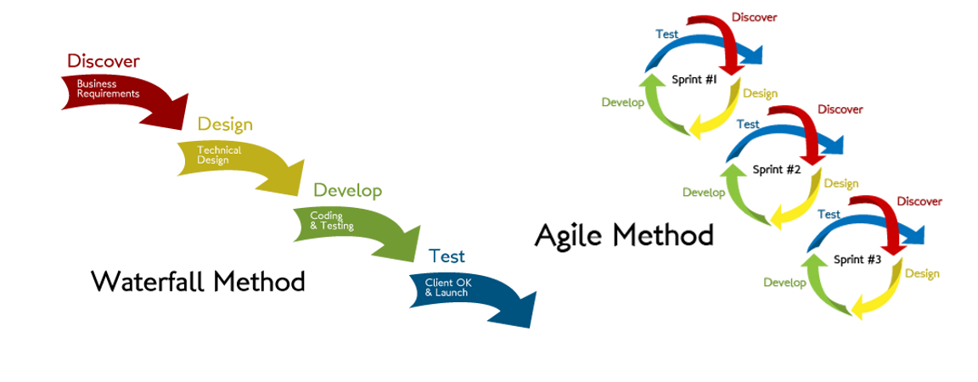
5. Project management
Plan was wrong
What we do
What we want

Slide 29
5. Project management
Risks are not mitigated, issues are hard to manage
No experience about Arduino
No experience about Client-server system
Not familiar with JSON
…
Why?
Learning curve was steeper than we imagined
Poor estimation made schedule delayed more
Additional issues came out before we mitigated risks
e.g. JSON library is not stable…

Slide 30
6. Lessons learned
Different people, different experience, and different understanding
Interface, interface, and interface!
Do not believe entirely open source
Used to implement, not used to design
Poor estimation
project management is hard

Slide 31
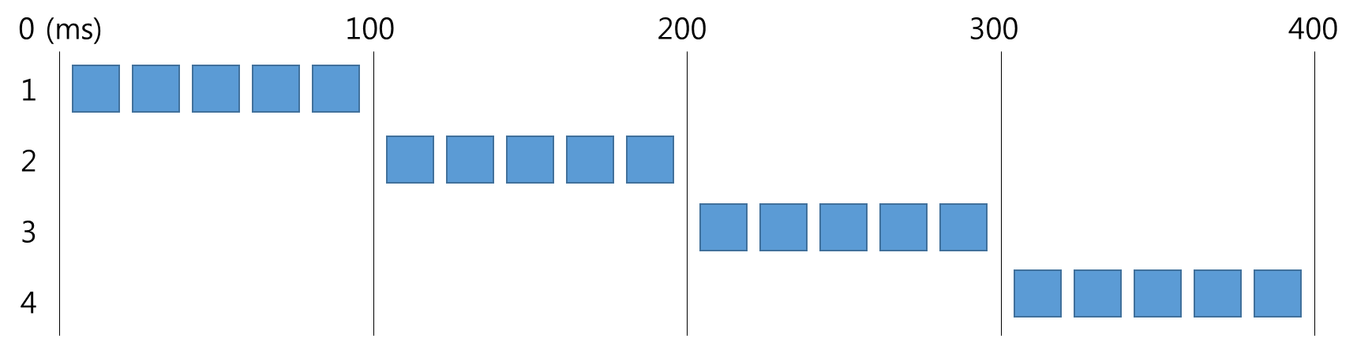
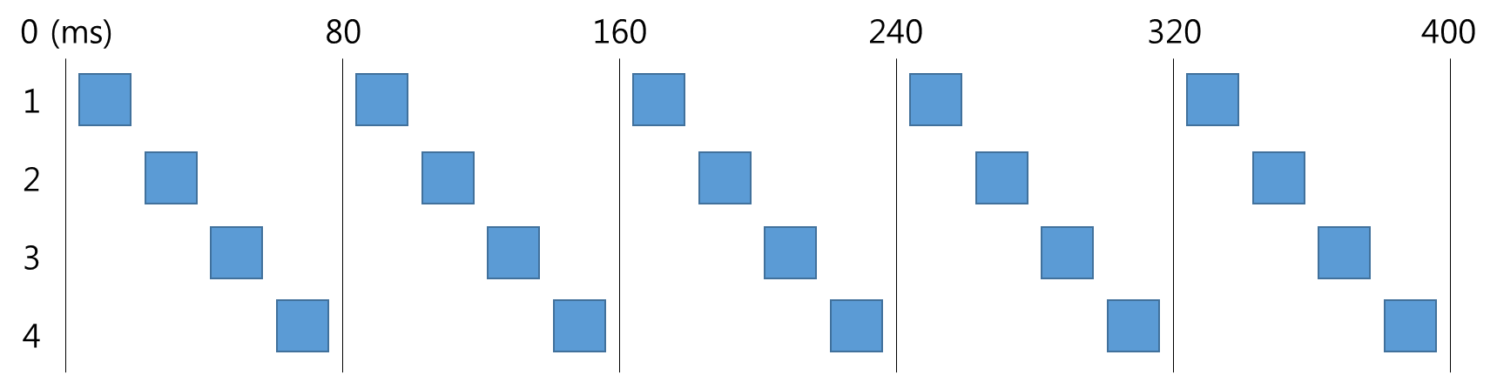
Appendix. Performance tactics
Manage sampling rate : best sampling rate for sensors
More sampling makes better accuracy
Less sampling makes better performance
Best answer is 5 time, between accuracy and performance
Sensor control process : #2
Sometimes sensor goes wrong with consecutive request
#1
#2
We can get stable sensor values

Slide 32
Appendix. Performance tactics
Schedule resource
In order to achieve low latency between devices, Arduino controls devices when the messages are arrived, and Arduino also sends the sensor values to server right after it gets.
Network (send/receive)
Control devices
Monitor sensors

Slide 33
Appendix. Availability
Heartbeat every 5 seconds
To inform alive, normal, safe and stable
Server knows device status, and notifies to attendant if failure detected

Slide 34
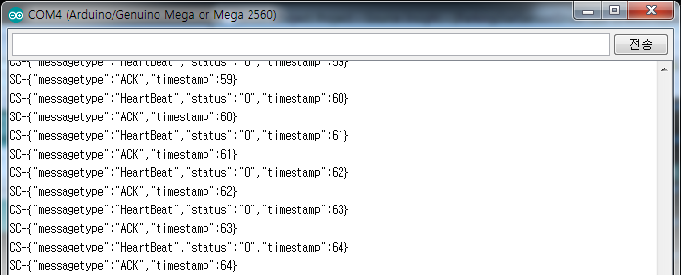
Appendix. Availability
Timestamp
To ensure the message transmission and reception
Applying between ParkServer and ParkingLot

Slide 35
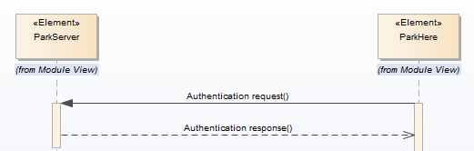
Appendix. Security
Authentication actors
System uses id/password to identify and authenticate actors. When any clients want to connect server, they should send message for authentication.
The server checks authentication information then grants connection to client. If it fails, server disconnect.

Slide 36
Appendix. Security
Encrypt data
Use “XXTEA” encryption algorithm
Arduino performance issue arise
It takes more than 5 seconds to encrypt ~200 bytes message.
Arduino also has a kind of limit to handle long message, experimentally under 200 bytes. But encryption makes message more than 1.5 times to 3 times. We already designed almost 200 bytes sized message, so it is hard to apply encryption thoroughly.
At this point, we decide to adopt encryption with small values, credit card information and password information.

